Slide 1
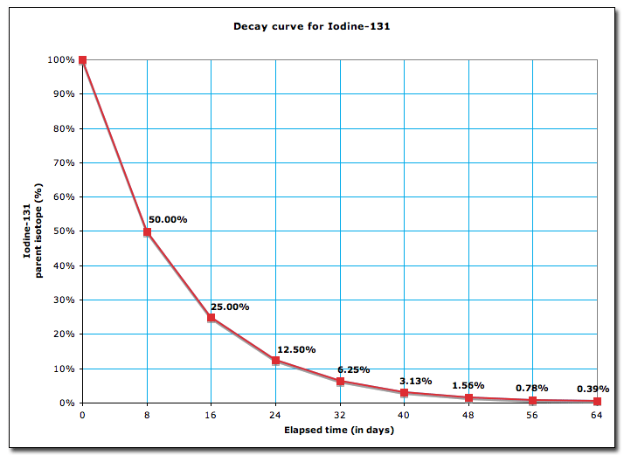
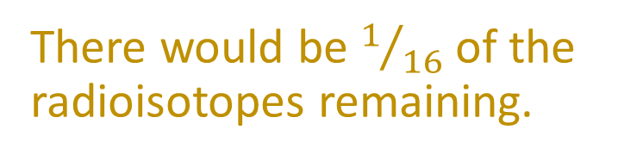
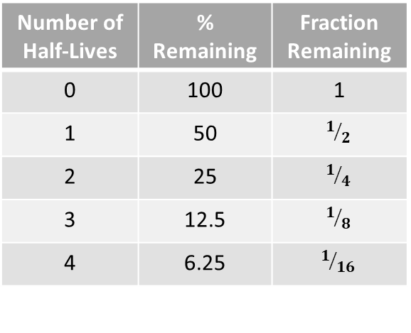
Daily Review
Number of Half-Lives | % Remaining | Fraction Remaining
0 | 100 | 1
1 | 50 | $$1/2$$
2 | 25 | $$1/4$$
3 | 12.5 | $$1/8$$
4 | 6.25 | $$1/{16}$$
Interpreting Half-Life Graphs
Use the graph to determine the half-life of the radioisotope. Calculate the number of half-lives that have passed. State the percentage or fraction of radioisotopes remaining in the sample.
What fraction of Iodine-131 remains after 32 days?
CFU 1
What is the half-life of the radioisotope?
The half-life of Iodine-131 is 8 days.
CFU 2
How many half-lives have passed?
In 32 days, four half-lives have passed.
There would be $1/{16}$ of the radioisotopes remaining.
CFU 3
What amount of the radioisotope remains?

Slide 2
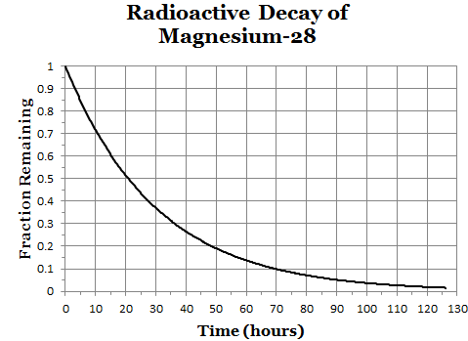
Daily Review
Number of Half-Lives | % Remaining | Fraction Remaining
0 | 100 | 1
1 | 50 | $$1/2$$
2 | 25 | $$1/4$$
3 | 12.5 | $$1/8$$
4 | 6.25 | $$1/{16}$$
Interpreting Half-Life Graphs
Use the graph to determine the half-life of the radioisotope. Calculate the number of half-lives that have passed. State the percentage or fraction of radioisotopes remaining in the sample.
What percentage of Magnesium-28 remains after 60 hours?
CFU 1
What is the half-life of the radioisotope?
The half-life of Magnesium-28 is 20 hours.
CFU 2
How many half-lives have passed?
In 60 hours, three half-lives have passed.
There would be 12.5% of the radioisotopes remaining.
CFU 3
What amount of the radioisotope remains?

Slide 3
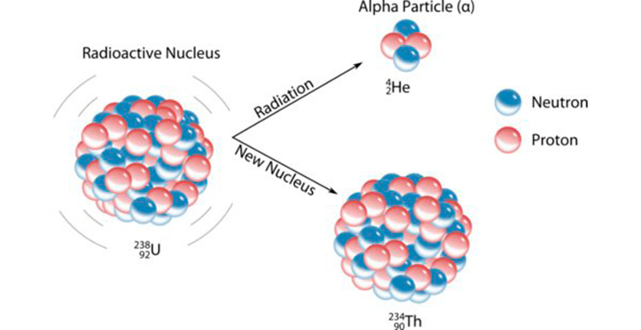
Daily Review
CFU 1
What makes up an alpha particle?
Alpha Radiation
During alpha decay, a nucleus emits an alpha particle.
An alpha particle is a group of two protons and 2 neutrons (the same as a helium nucleus).
Alpha decay occurs in very large nuclei such as uranium-238 and radium-226.
CFU 2
What type of nucleus is an alpha particle the same as?
CFU 3
When does alpha decay occur?

Slide 4
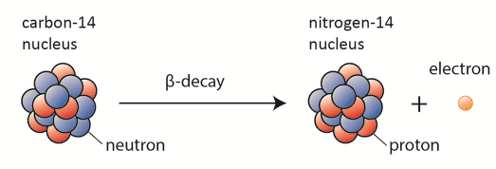
Daily Review
CFU 1
What makes up a beta particle?
Beta Radiation
During beta decay, a nucleus emits a beta particle.
A beta particle is produced when a neutron in the nucleus decays into a proton and an electron.
The electron is the beta particle that leaves the atom.
CFU 2
How does beta decay occur?

Slide 5
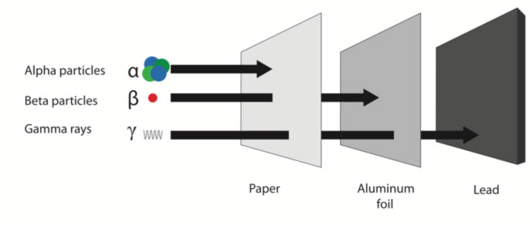
Daily Review
Stopping Radiation
The three types of radiation can be stopped by different materials.
Think, Pair, Share: Why can alpha particles be stopped by paper, but beta particles cannot?

Slide 6
Nuclear Fusion and Fission Year 9 Science

Slide 7
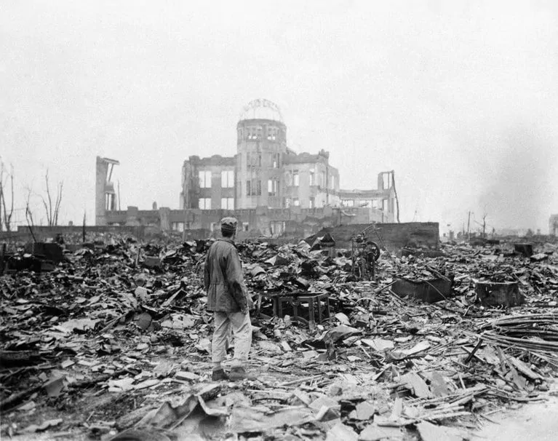
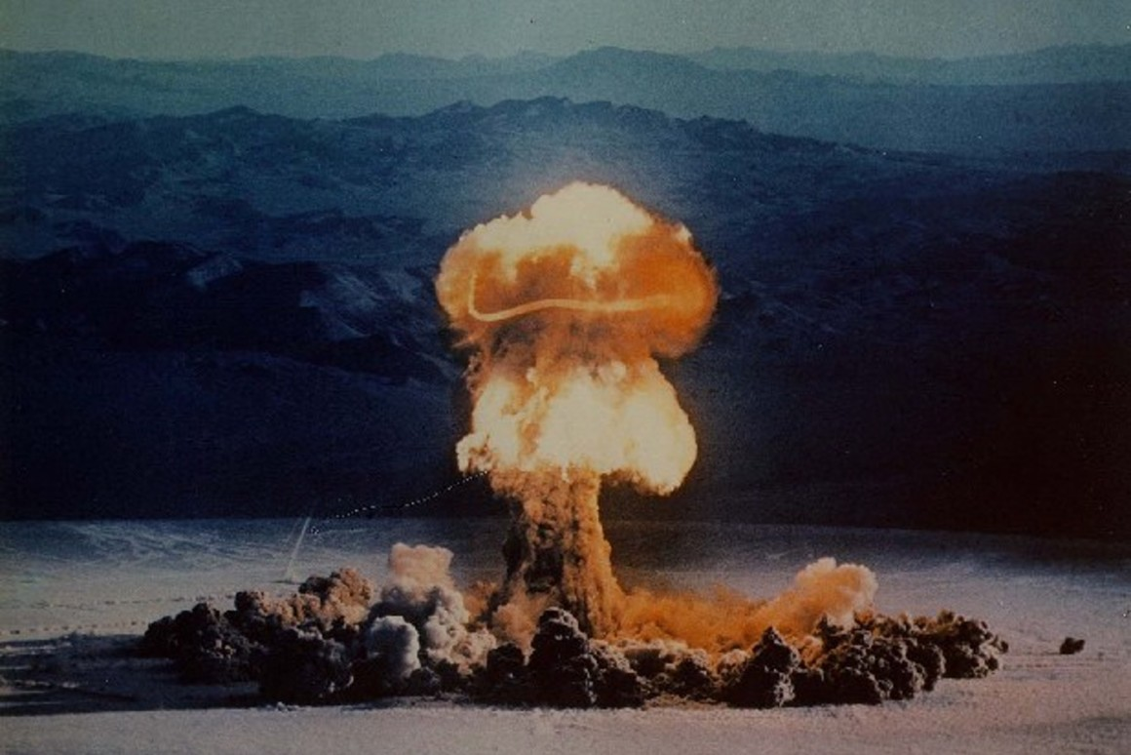
Learning Objectives
CFU
What are we going to learn?
Describe the processes of nuclear fusion and fission.
Identify uses of nuclear fusion and fission.
Describe the impacts of atomic bombs based on distance from detonation site.
Activate Prior Knowledge
In World War II, atomic bombs were dropped on Hiroshima and Nagasaki in Japan.
Think-pair-share: What are some short term and long term effects of these bombs?

Slide 8
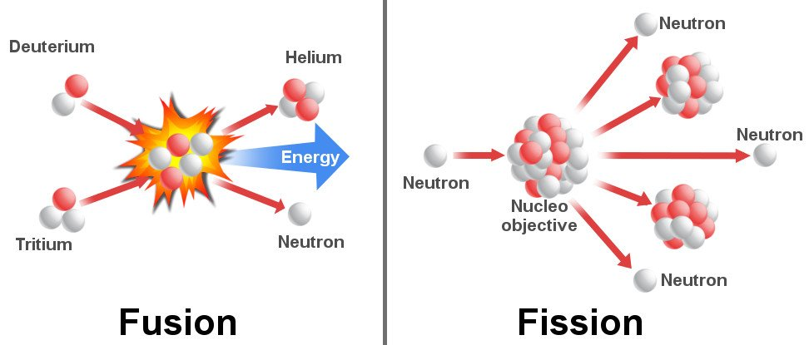
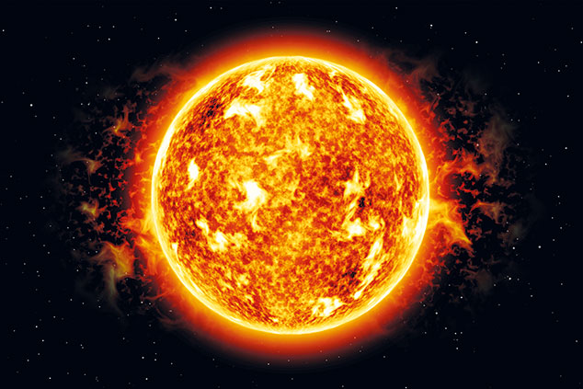
Concept Development
Vocabulary
Nuclei: plural of nucleus
CFU 1
What happens during a nuclear fusion reaction?
Nuclear Fusion
Fusion reactions happen when two small nuclei fuse together.
When the atoms fuse, a large amount of energy is released.
For example, when deuterium (hydrogen-2) and tritium (hydrogen-3) fuse, they form a helium nucleus and a neutron, and release energy.
Nuclear fusion reactions occur naturally in stars.
CFU 2
How is a helium nucleus formed by fusion?

Slide 9
Concept Development
Vocabulary
Nuclei: plural of nucleus
CFU 1
Why would nuclear fusion be a good source of electricity?
Nuclear Fusion
Fusion reactions have been used in hydrogen bombs and nuclear weapons.
Even though nuclear fusion reactions release a large amount of energy and no nuclear waste, they are not used to produce electricity.
This is because large amounts of heat are released from these reactions and we have not developed the technology to contain them.
CFU 2
Why are nuclear fusion reactions not used for electicity production?

Slide 10
Concept Development
CFU 1
What happens during a nuclear fission reaction?
Nuclear Fission
During a fission reaction, a large unstable nucleus splits into two smaller ones.
A neutron is fired into the nucleus of the atom.
This causes the atom to split into two smaller atoms.
When the atom splits, a large amount of energy is released, along with some neutrons.
CFU 2
How is a fission reaction triggered?

Slide 11
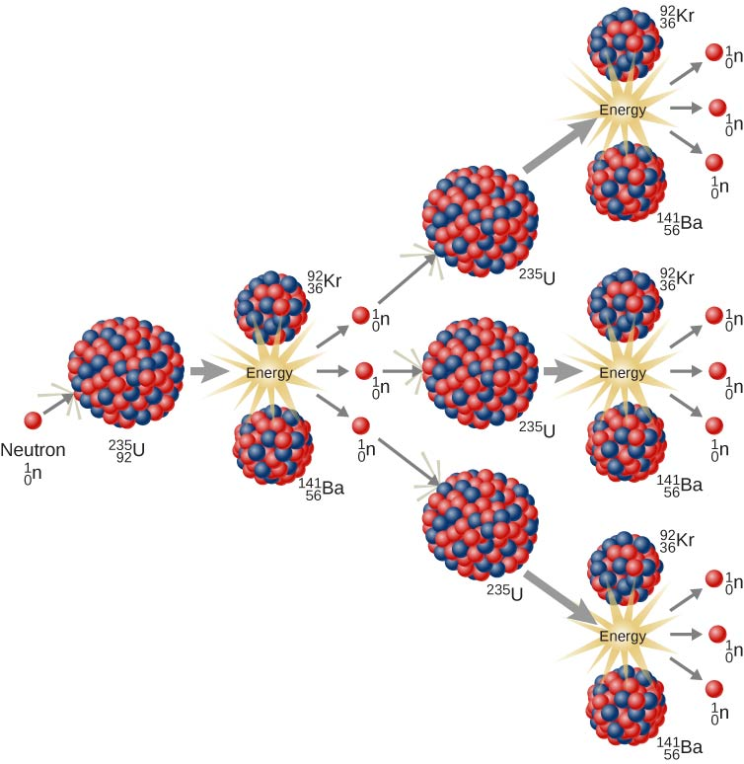
Concept Development
CFU 1
What happens to the neutrons produced in a fission reaction?
Nuclear Fission
For example, when uranium-235 is hit by a neutron, it becomes uranium-236, which is unstable.
U-236 breaks apart into two smaller nuclei (krypton and barium) and some neutrons.
The neutrons can then collide with other uranium-235 nuclei, triggering a chain reaction.

Slide 12
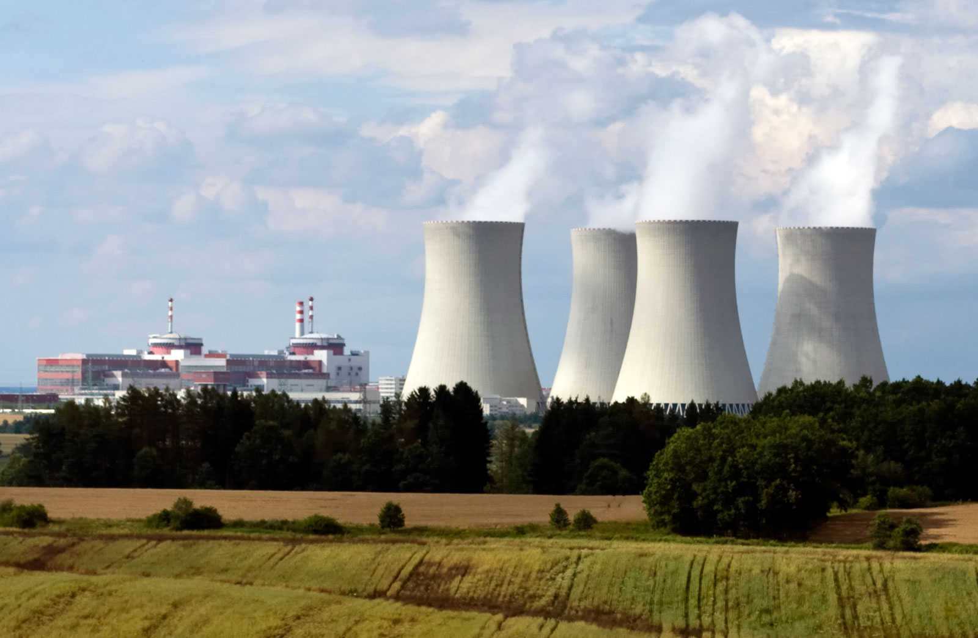
Concept Development
CFU 1
How are nuclear fission reactions useful and how can they be harmful?
Importance of Uranium Fission
An uncontrolled chain reaction results in a nuclear explosion (e.g. an atomic bomb).
A controlled chain reaction can be used to produce electricity (e.g. a nuclear reactor).

Slide 13
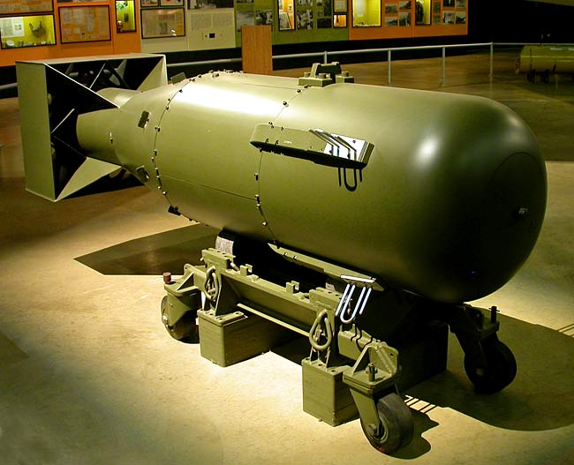
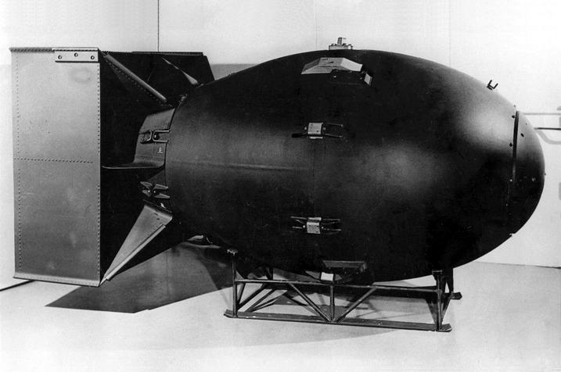
Concept Development
CFU 1
Watch the video, and list some of the effects of the bombs.
Atomic Bombs
In World War II, two nuclear fission bombs were dropped in Japan by US pilots.
The first bomb, nicknamed “Little Boy”, was dropped on Hiroshima on August 6, 1945.
It contained 64 kg of uranium-235, but released 63 TJ (63 000 000 000 000 J) of energy when it exploded, equivalent to 15000 tons of TNT.
The second bomb, known as “Fat Man”, was dropped on Nagasaki three days later.
It contained a mere 6.4 kg of plutonium, but exploded with the energy of 21000 tons of TNT (88 TJ).

Slide 14
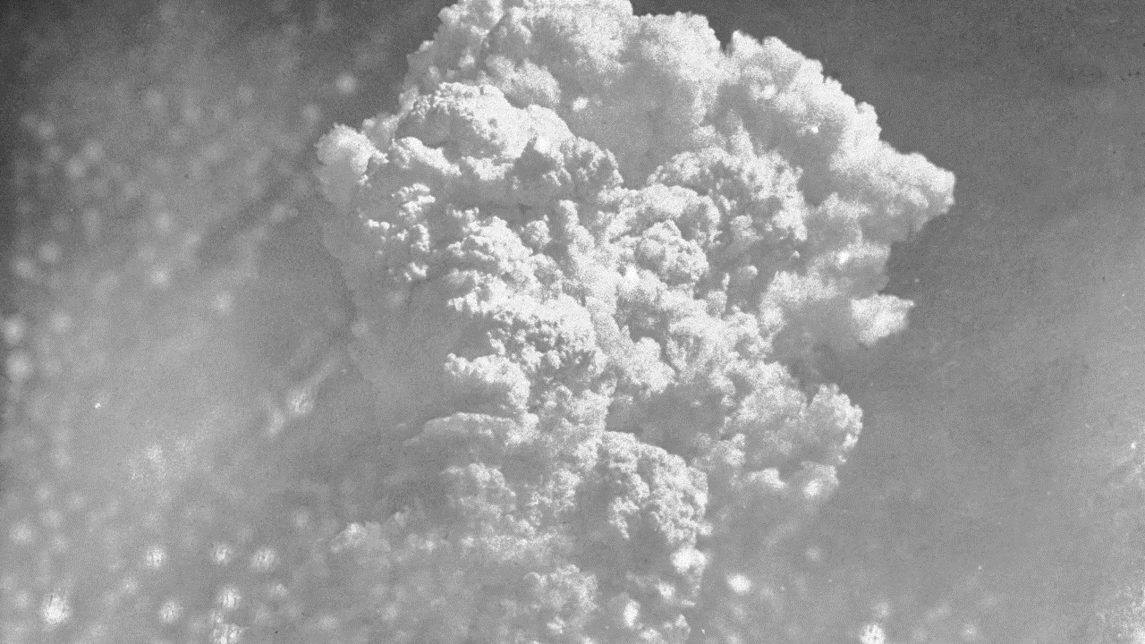

Slide 15
Skill Development / Guided Practice
Collect a worksheet from your teacher and use the information on the next few slides to describe the impacts of an atomic bomb the same size as “Little Boy”, if it was dropped on Perth.
Blast Effects
Fireball: Flames incinerate most buildings, objects, and people.
Radiation: Gamma and other radiation are so intense that 50% or more people will die with in several hours to several weeks.
Air blast: A shock wave which is powerful enough to collapse buildings, rupture eardrums, and cause other injuries / fatalities.
Thermal radiation: Thermal and UV radiation causes 3rd degree burns, which are often painless because they destroy nerves.

Slide 16
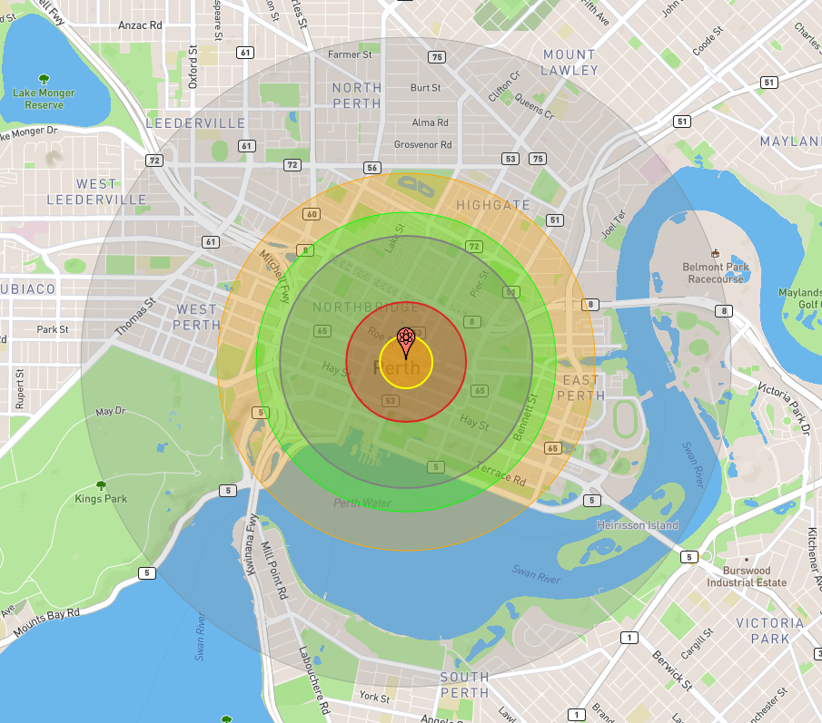
Skill Development / Guided Practice
Draw the impact zones on your map, colour code them and complete the key. (you can use different colours to the map shown)
Yellow: Fireball (0.17 km²)
Red: Air Blast - 20 psi pressure (0.9 km²)
Lilac: Air Blast - 5 psi pressure (4 km²)
Green: Radiation (6 km²)
Orange: Thermal radiation (9 km²)
Grey: Air Blast - 1 psi pressure (26 km²)

Slide 17
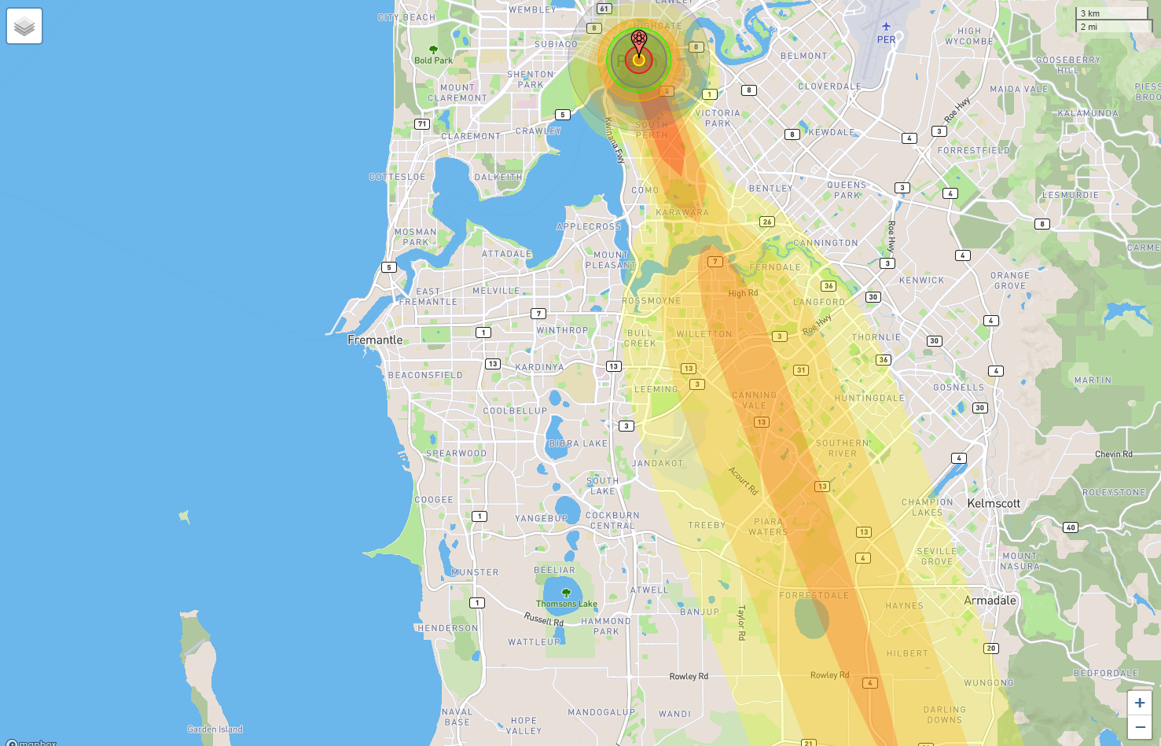
Skill Development / Guided Practice
Write the description of nuclear fallout on the second page of the worksheet.
Nuclear fallout is the residual radioactive material in the air, in the form of dust and ash.
It got its name because it “falls out” of the sky after the explosion and shockwave have passed.
Nuclear fallout is measure in rads, which is the absorbed radiation dose.

Slide 18
Skill Development / Guided Practice
Draw the fallout zones on your map, colour code them and complete the key. (you can use different colours to the map shown)
Red: 1000 rads per hour (5 km)
Dark orange: 100 rads per hour (32 km)
Light orange: 10 rads per hour (72 km)
Yellow: 1 rad per hour (112 km)

Slide 19
Relevance
Many countries use nuclear fission to produce electricity, despite the risks of nuclear reactions.
Following the atomic bombing of Japan in WWII, many countries developed their own nuclear weapons.
The full extent of illnesses resulting from the bombing of Japan are still being monitored and evaluated, to help us understand the potential impacts of future nuclear disasters.

Slide 20
Skill Closure
Explain the difference between fusion and fission.
Skill Closure
Name and describe two direct impacts from an atomic bomb.
Skill Closure
What is nuclear fallout and why does it impact a larger area than the direct impact from the bomb?

Slide 21
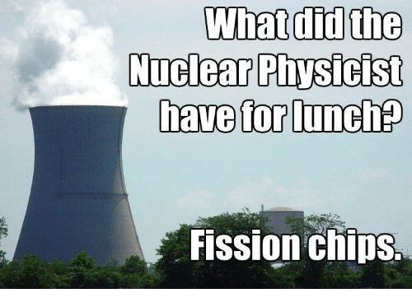
Independent Practice
Go to the website below:
nuclearsecrecy.com/nukemap/
See what impact different sizes and types of atomic bombs would have on Perth. You can change the wind direction of the nuclear fallout, and whether the bomb detonates on the surface or in the air.

